Slide 1
Installation Guide
(Eclipse Plug-in － JUtils 3.1)
2008. 12. 16
CODELABOR
Shin Sang Jae (codelabor@gmail.com)

Slide 2
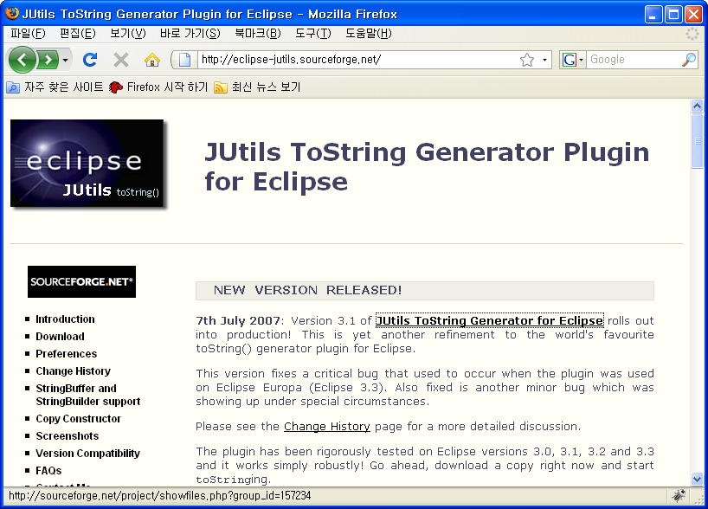
JUtils
Site
Officical Site: http://eclipse-jutils.sourceforge.net/

Slide 3
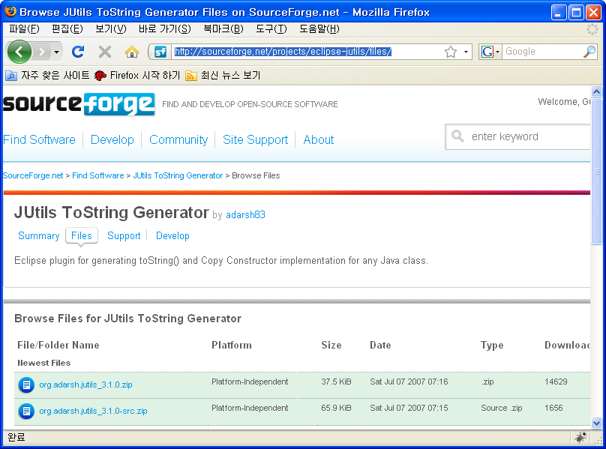
JUtils
Download
Download Site URL: http://sourceforge.net/projects/eclipse-jutils/files/
Download File: org.adarsh.jutils_3.1.0.zip

Slide 4
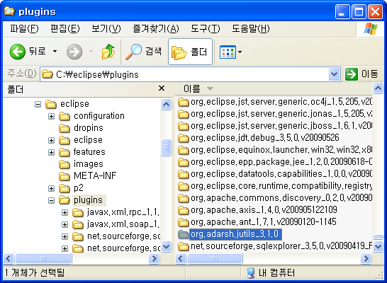


JUtils
Unzip / Install
Unzip
Install into Eclipse plugin directory
  Directory: C:/eclipse/plugins

Slide 5
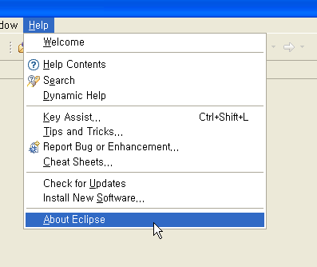
JUtils
Software Updates
Restart Eclipse
Menu
  Help > About Eclipse

Slide 6
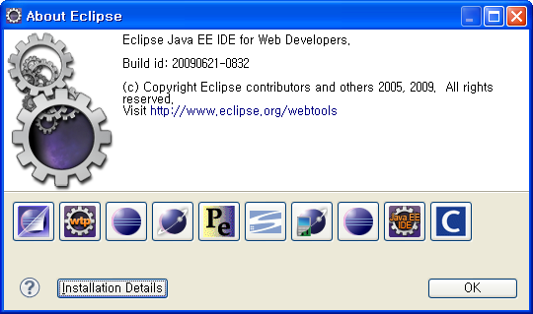
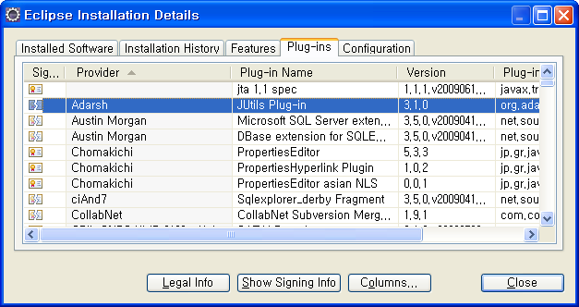
JUtils
Software Updates
About Eclipse Window
  Install Details
Eclipse Installation Details Window
  Plug-ins

